Slide 1
H-Kr Scattering and Beyond - Quantum scattering with a spherically symmetric potential
Yunjie Wang
12/03/2020

Slide 2
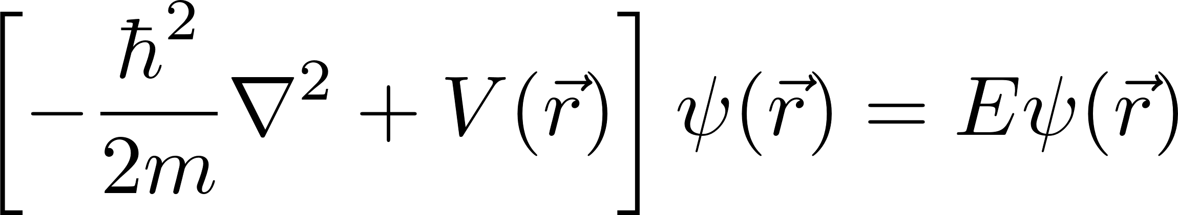
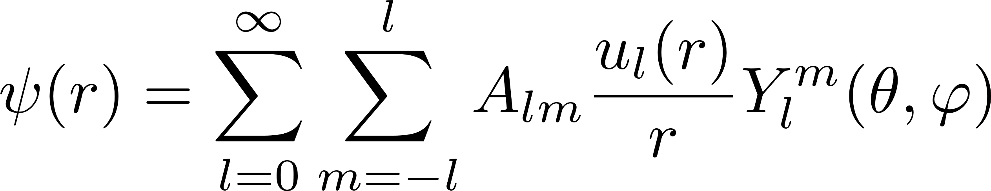
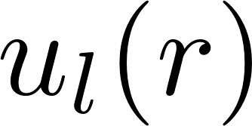
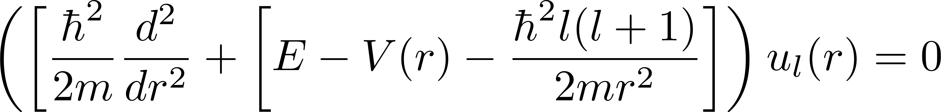
Problems
Three Dimensional PDE
Because of the symmetric property of the potential, the solution of the equation could be written
And the satisfies
3-D into 1-D!

Slide 3
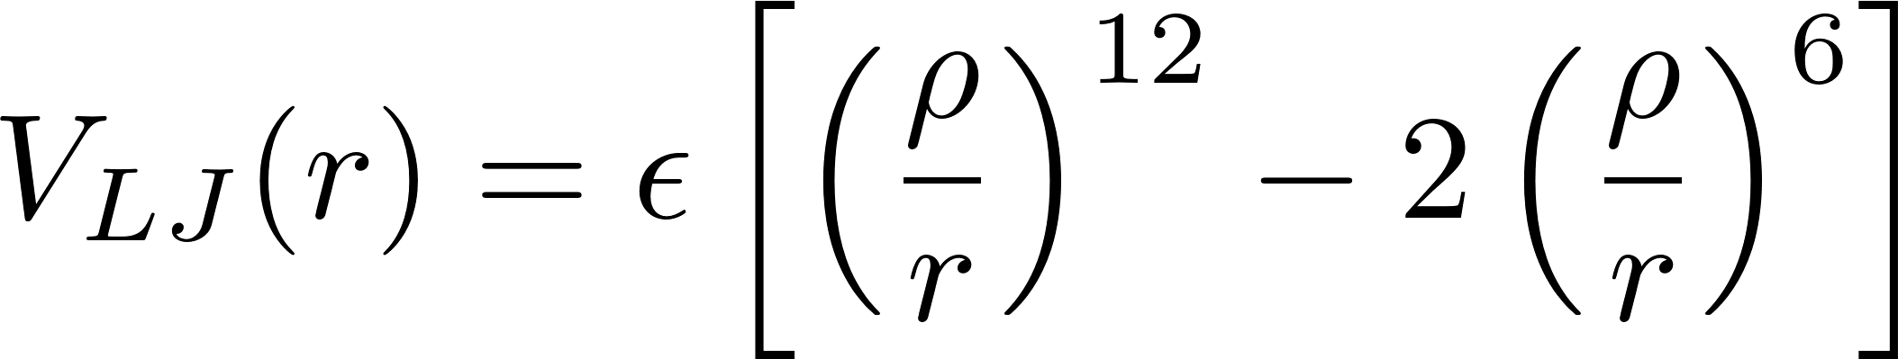

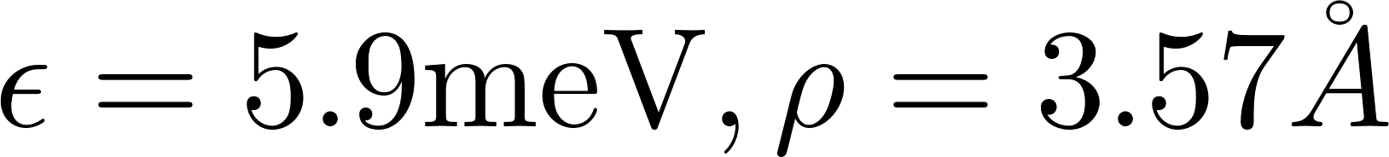
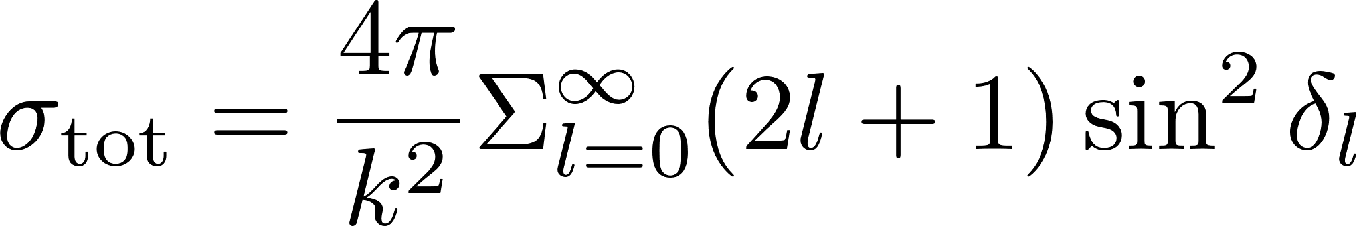
Problems
Lennard-Jones Potential
The parameter
For Hydrogen-Krypton,
Physical quantity to calculate, the total(integrated) cross section:

Slide 4
Algorithms
Numerov Algorithm for the Schrodinger equation
Initial Points(Approximated Solution)
Ending Points(The points the effective potential roughly goes to zero)
Truncation of the infinite sum
We will see in the final plot, the larger L will not contribute much to the total cross sections

Slide 5
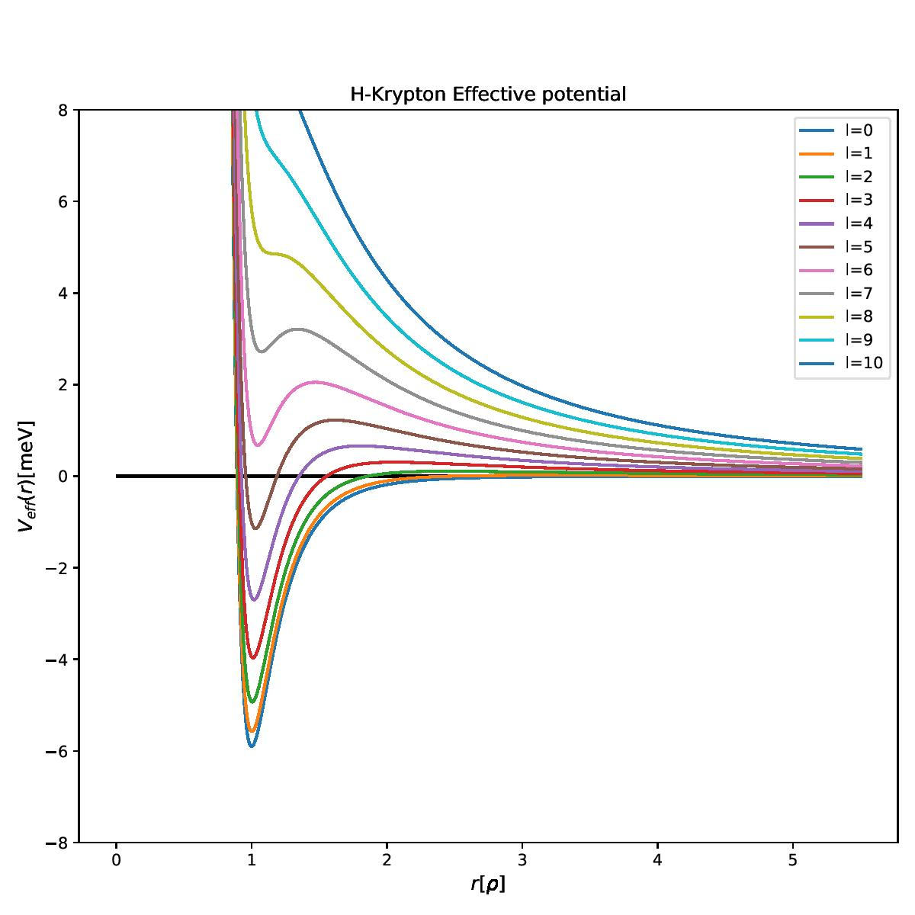
Results
The effective potential:
For relatively large L, the potential looks like:
hard core + well + barrier
Quasi-bound state(unstable bound state) possible
Resonate in the well
Eventually decay

Slide 6
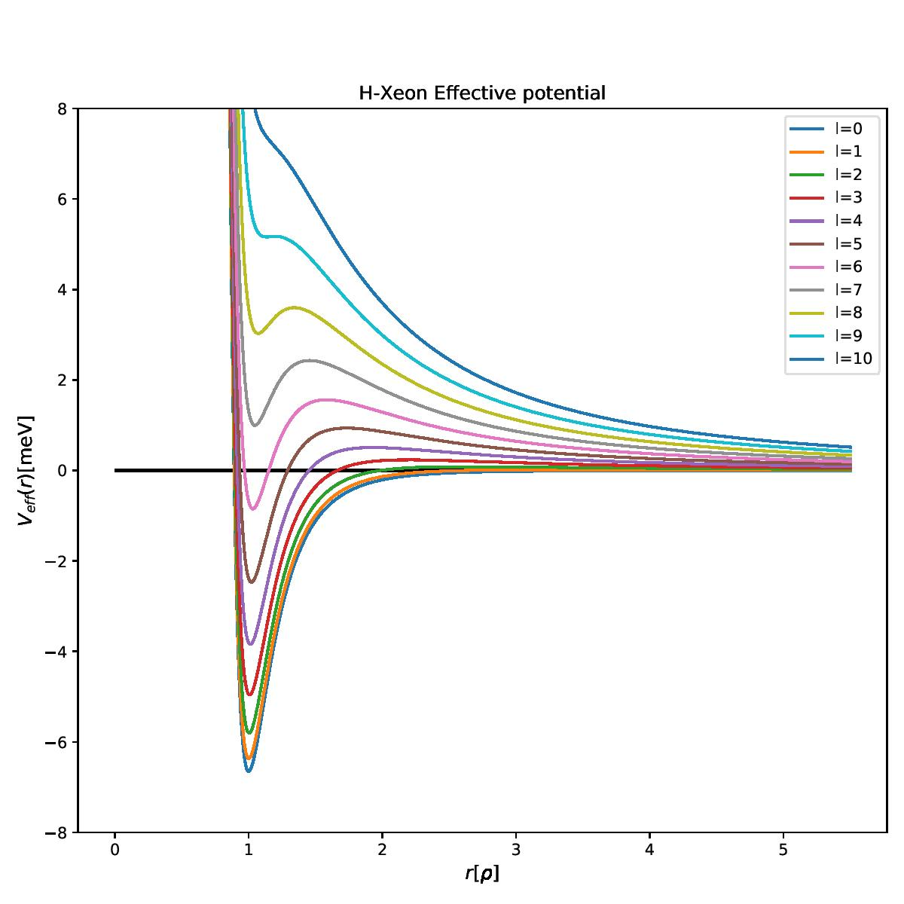
Results
The effective potential:
For relatively large L, the potential looks like:
hard core + well + barrier
Quasi-bound state(unstable bound state) possible
Resonate in the well
Eventually decay

Slide 7
Results: Radial Wave Function
The radial wave function will prove the guess about the quasi-bound state
You will see the jump around the resonance energy.
For Krypton, the energies are 0.50 meV, 1.59 meV, 2.94 meV
The dashed lines are the injected energy. Different subplots represents the case for different L, and the L is at the bottom right.

Slide 8
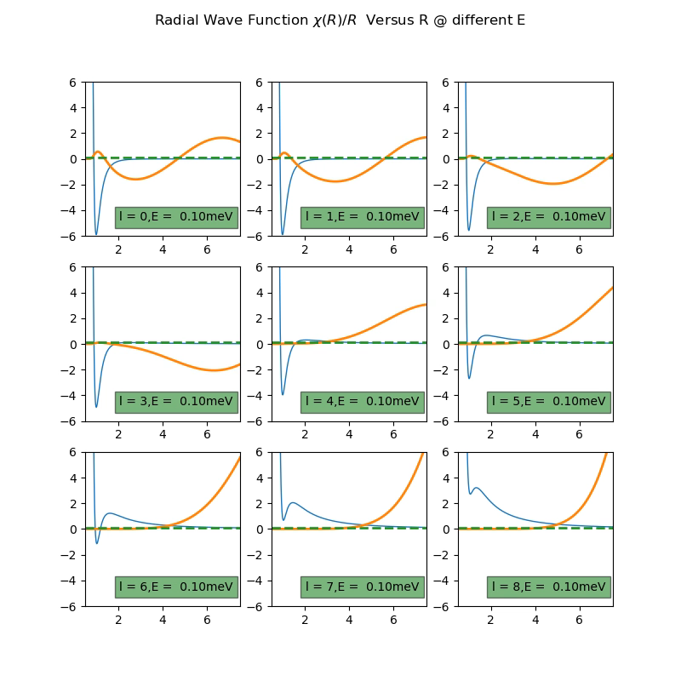
For Krypton
0.50 +/- 0.02meV
1.59 +/- 0.06meV
2.94 +/- 0.12meV

Slide 9
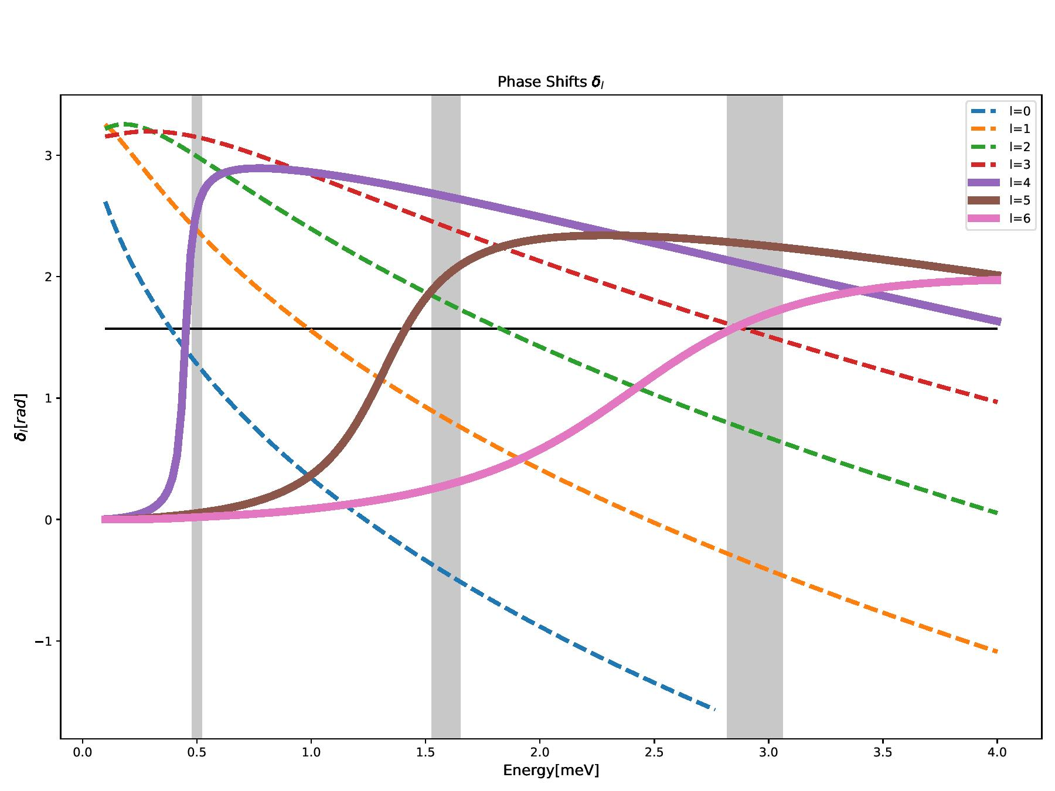

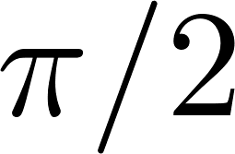
Results: Phase Shift
The relation between total cross section and phase shift
In order to get the sharp peak, the needs to be
For Krypton, there are 3 lines reaching
The grey shaded area is the resonant energies recorded in the paper

Slide 10
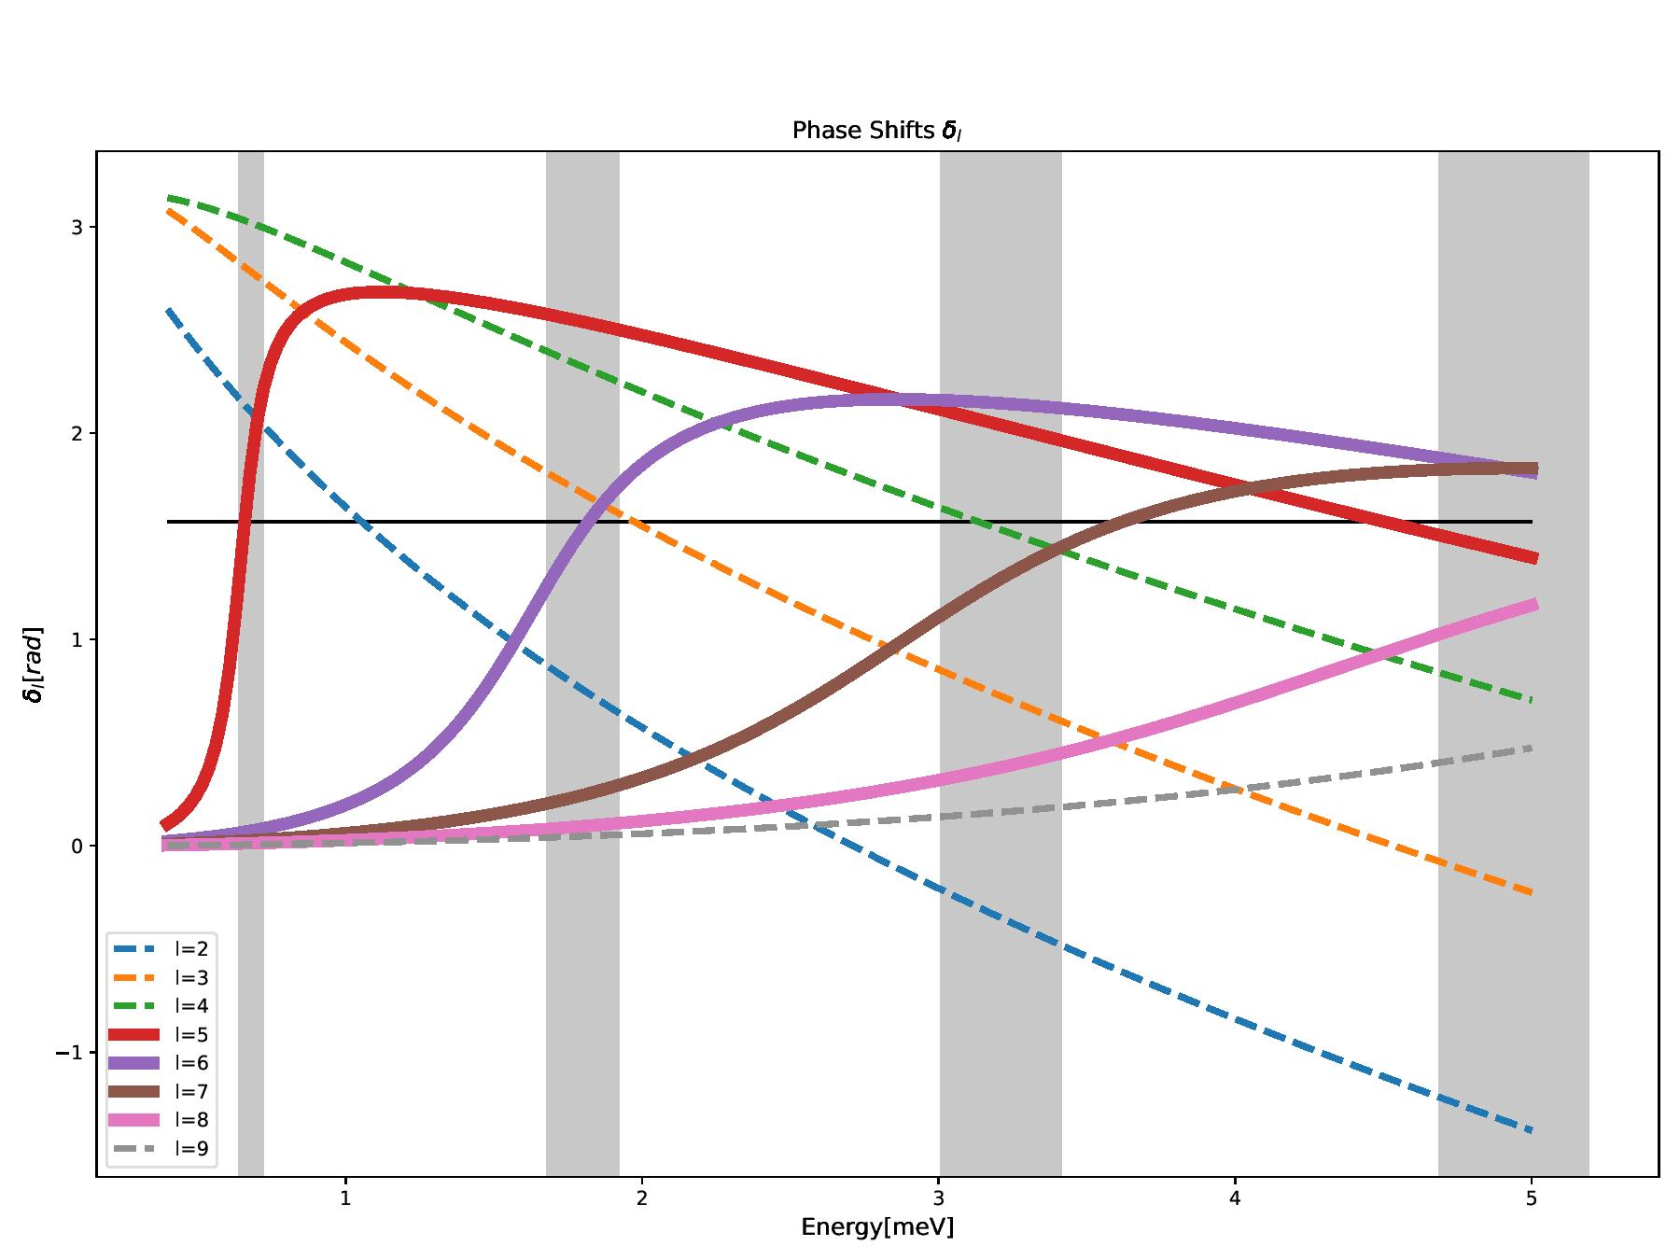
Results: Phase Shift
The relation between total cross section and phase shift
In order to get the sharp peak, the needs to be
For Xeon, there are 4 lines reaching
The grey shaded area is the resonant energies recorded in the paper

Slide 11
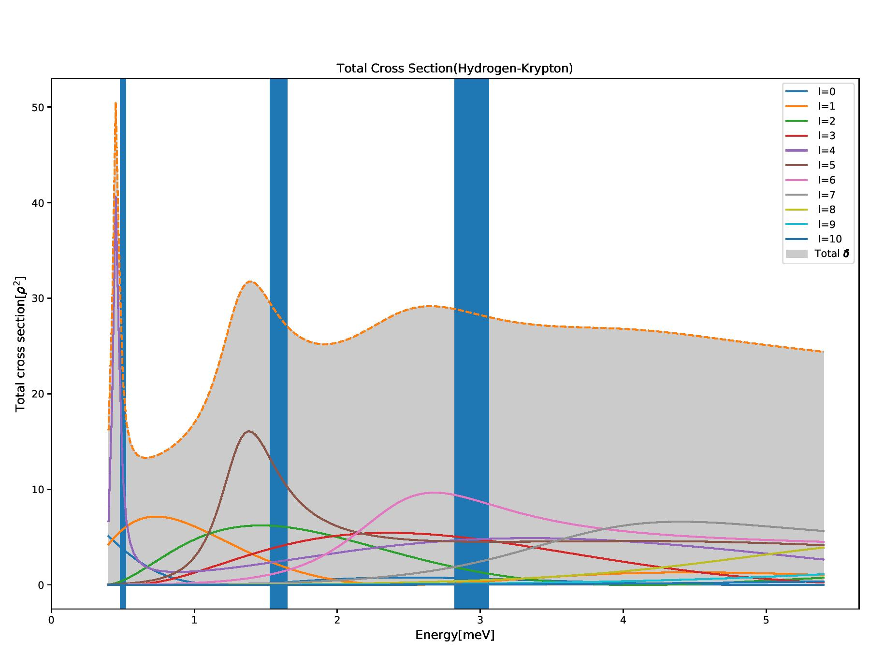
Results: Total Cross Section
After truncate the L at 10, we could clearly see the peak at their resonant energies both in Krypton and Xeon case

Slide 12
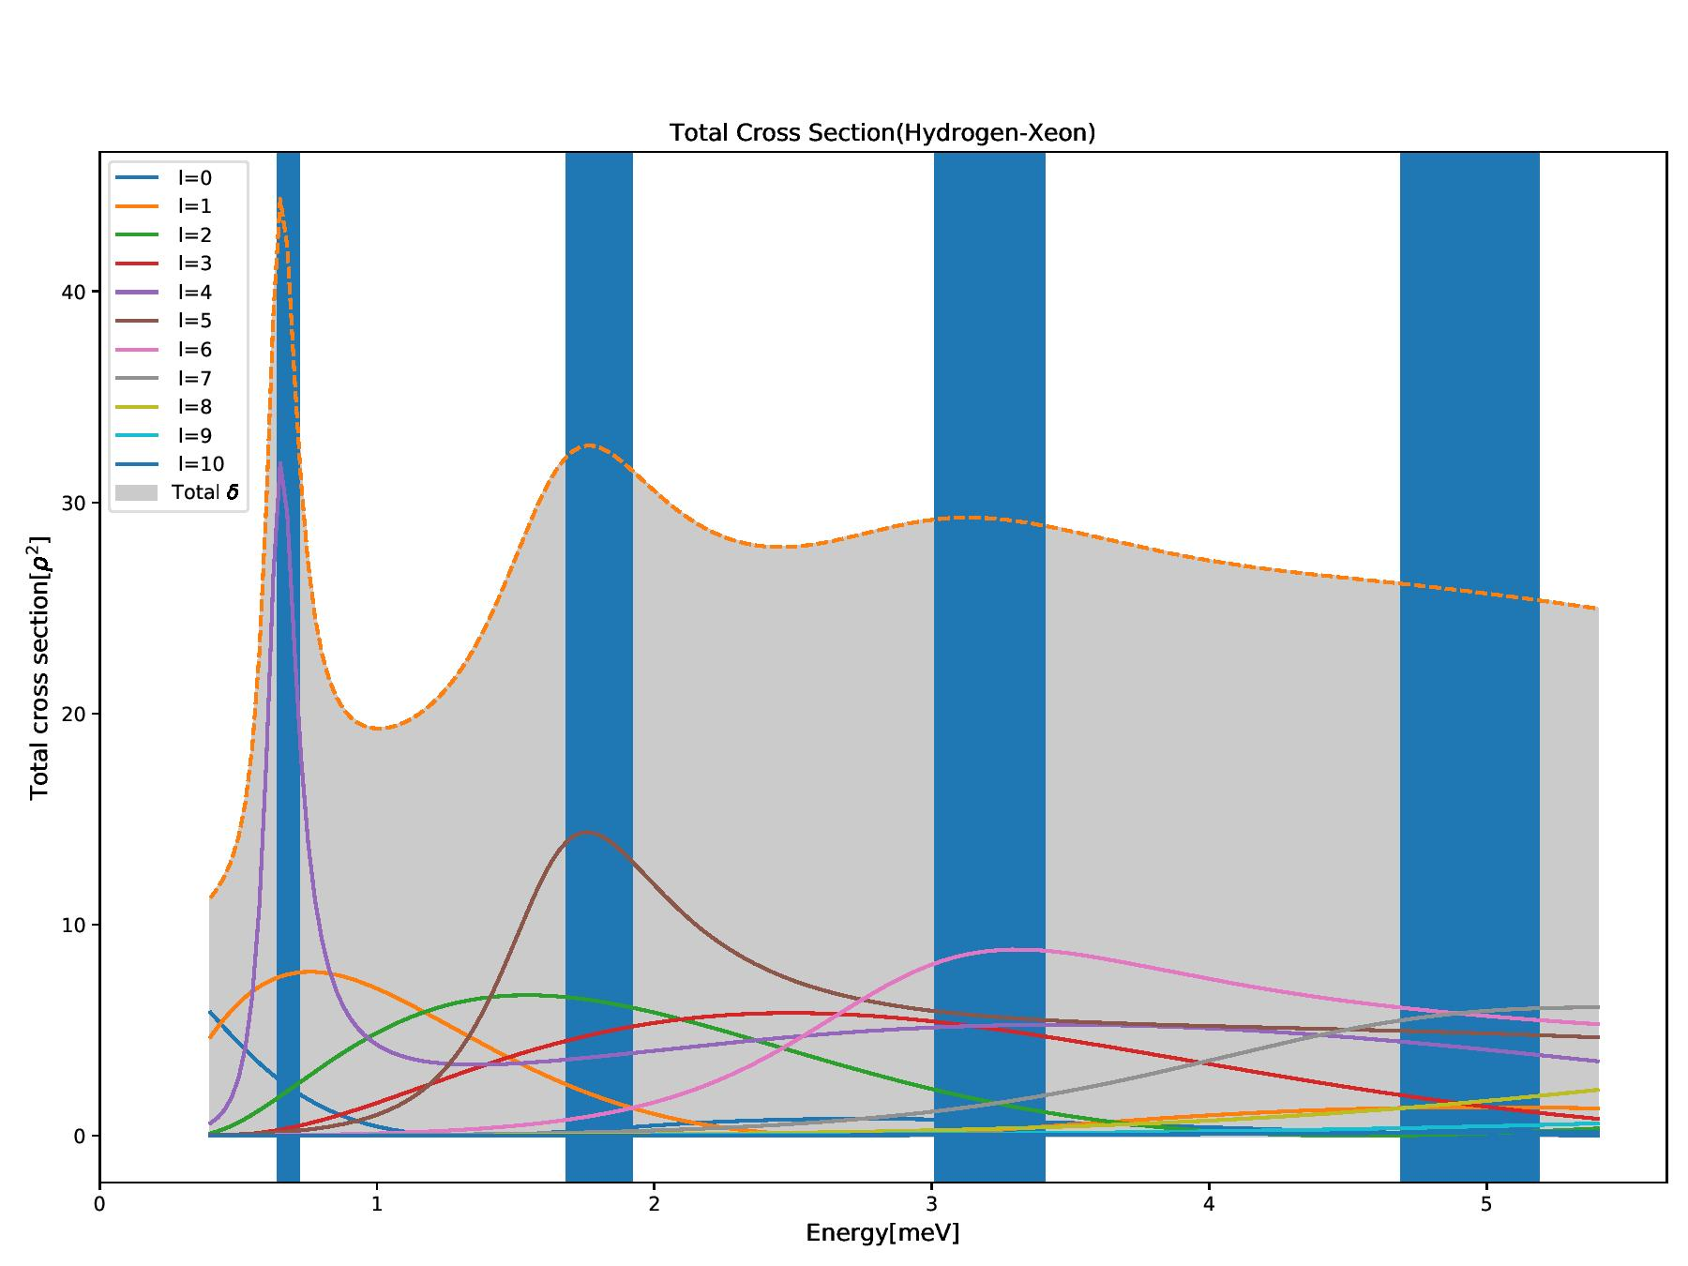
Results: Total Cross Section
After truncate the L at 10, we could clearly see the peak at their resonant energies both in Krypton and Xeon case

Slide 13
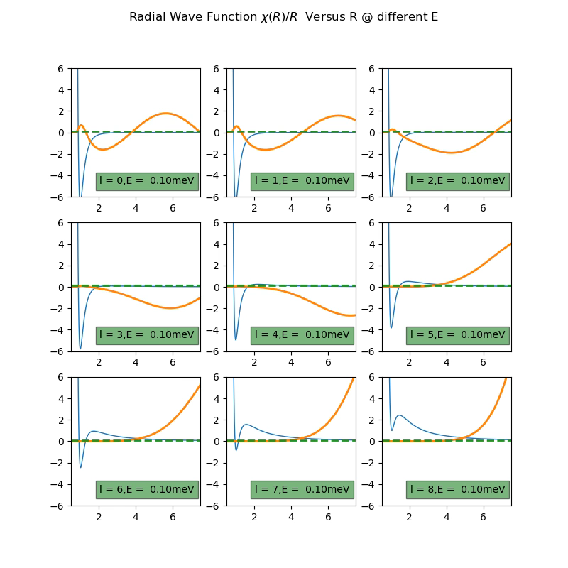
For Xeon
0.68 +/- 0.04meV
1.80 +/- 0.12meV
3.21 +/- 0.20meV
4.94 +/- 0.25meV

